Slide 1
Emergency Exit detection for the visually impaired people
- 자율지능 IOT 팀 프로젝트 최종 발표 -
20520052 이도현 20520053 이새롬

Slide 2

1. Introduction (1/2)
Motivation
Blind People can’t identify the sign
Additionally, in workplace there are various obstacles that looks similar with the sign.
doorplate, nameplate, and signboard.
It has been an important issues for safety!
Escape method is unsuitable for blind people.

Slide 3
1. Introduction (2/2)
Purpose
Propose effective emergency exit detection system for blind people.
Aims at helping visually impaired people with navigating unfamiliar environments in real-time.

Slide 4
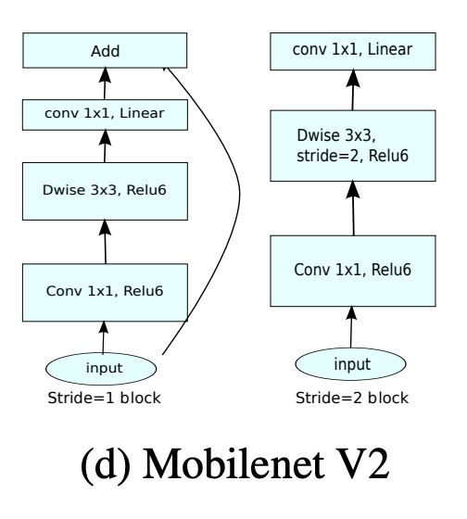
2. Method (1/2)
Process
Emergency Exit detection
Transfer Learning based on the pretrained model
Mobilenet_V2 ¹
Pre-trained on ImageNet
Classes referring the emergency exit should be added.
Emergency exits are classified by street sign according to the case of Real example
Re-trained with custom dataset
Indoor Sign Dataset(ISD) ²
Indoor object detection dataset ³
¹ M. Sandler, A. Howard, M. Zhu, A. Zhmoginov and L. -C. Chen, "MobileNetV2: Inverted Residuals and Linear Bottlenecks," 2018 IEEE/CVF Conference on Computer Vision and Pattern Recognition, 2018, pp. 4510-4520.
² Almeida, J. L., Flores, F. C., Roecker, M. N., Braga, M. A., & Costa, Y. M. (2019). An Indoor Sign Dataset (ISD): An Overview and Baseline Evaluation. In VISIGRAPP (4: VISAPP) (pp. 505-512).
³ Adhikari, B., Peltomaki, J., Puura, J., & Huttunen, H. (2018, November). Faster bounding box annotation for object detection in indoor scenes. In 2018 7th European Workshop on Visual Information Processing (EUVIP) (pp. 1-6). IEEE.

Slide 5
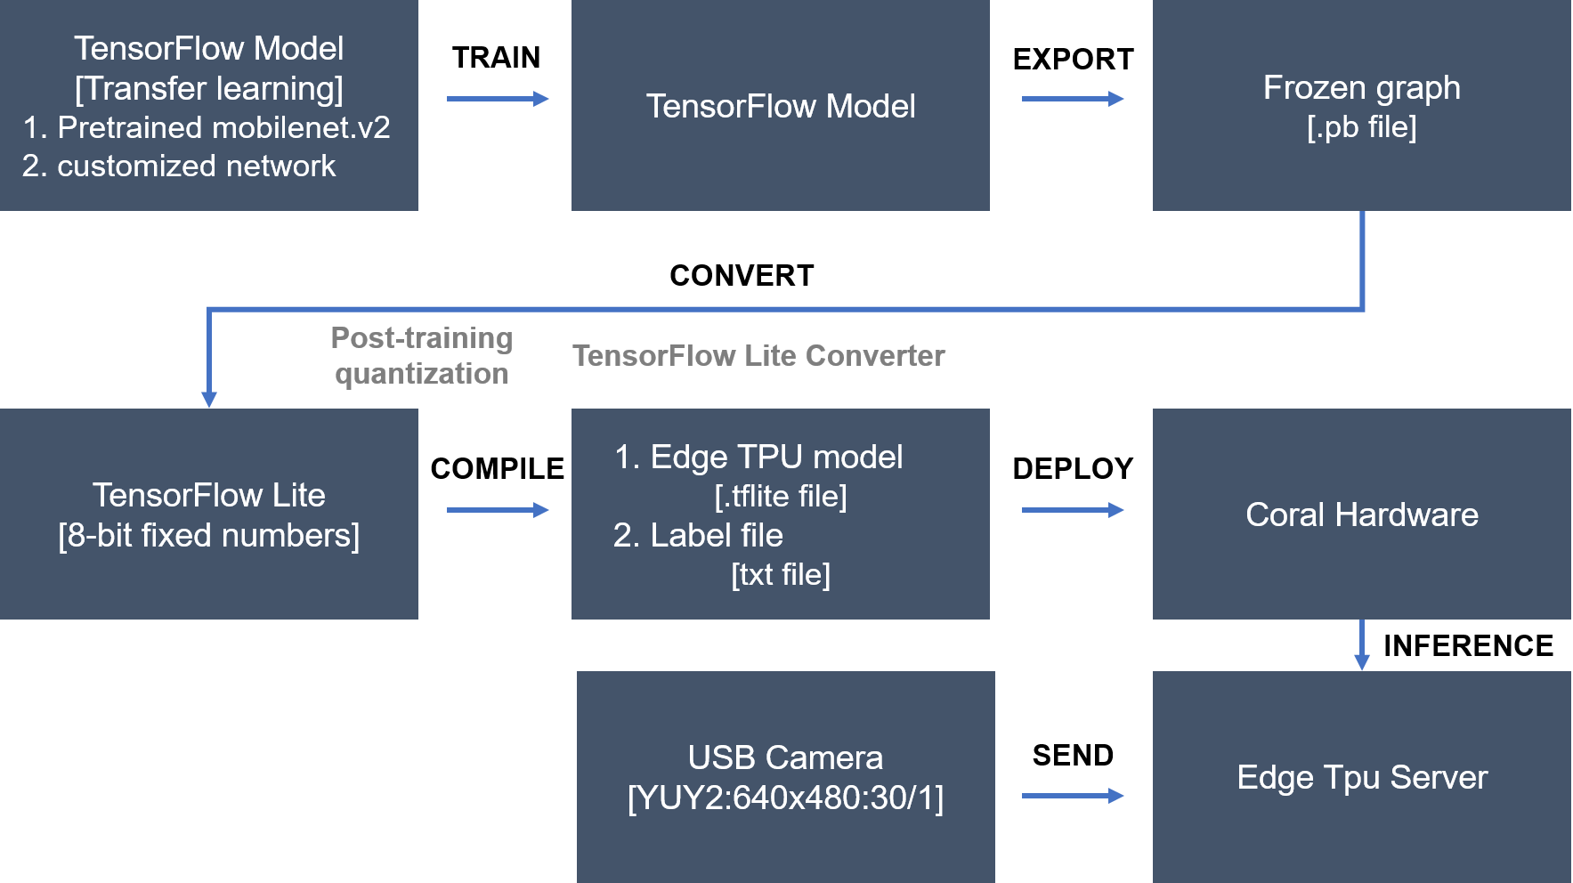
2. Method (2/2)
Process (continue)
Sequence diagram
Figure 1. Sequence diagram of project

Slide 6
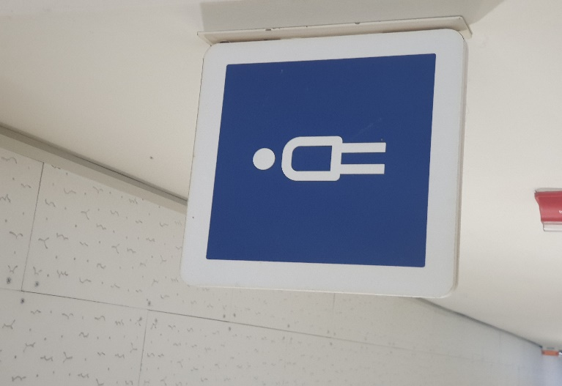
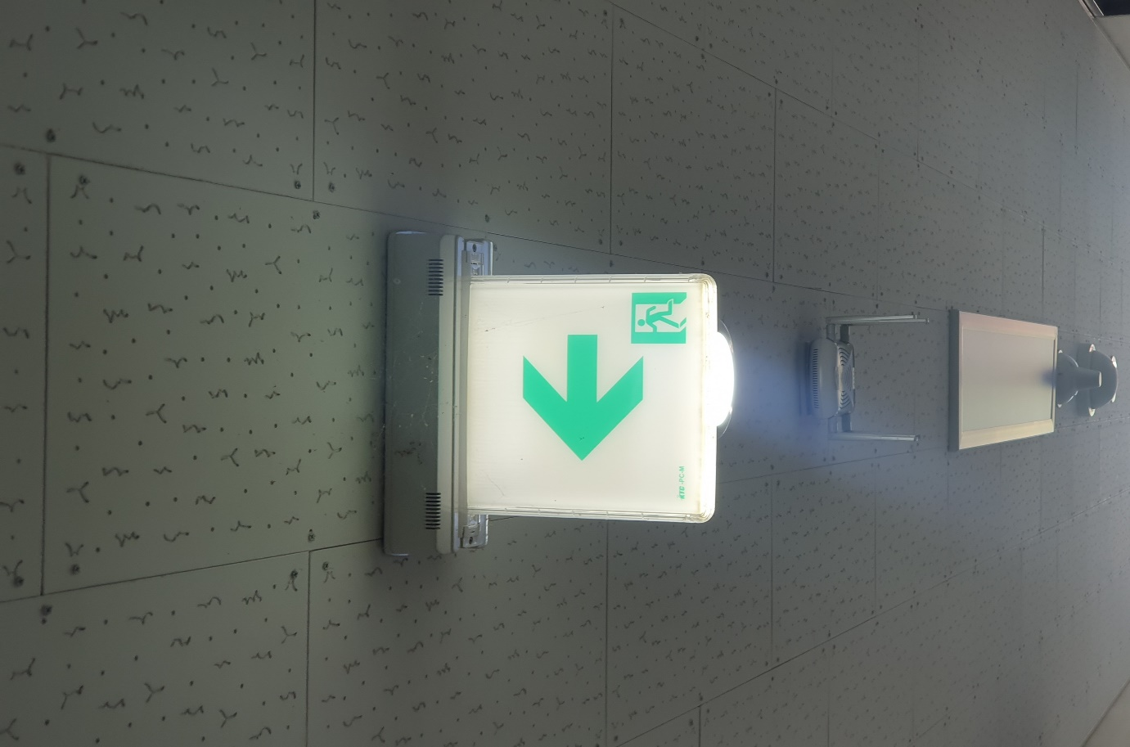
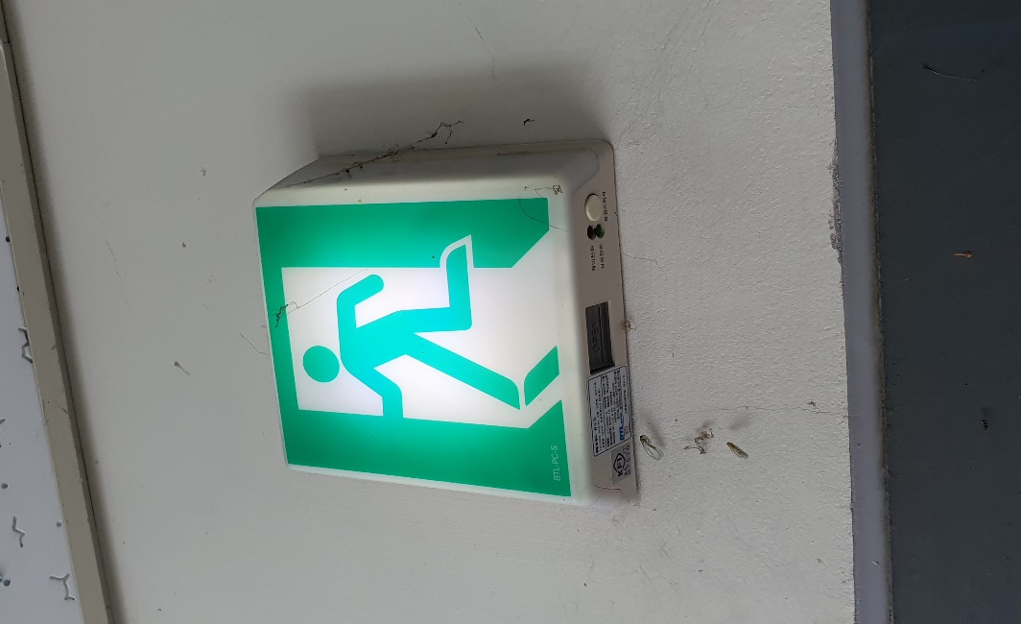
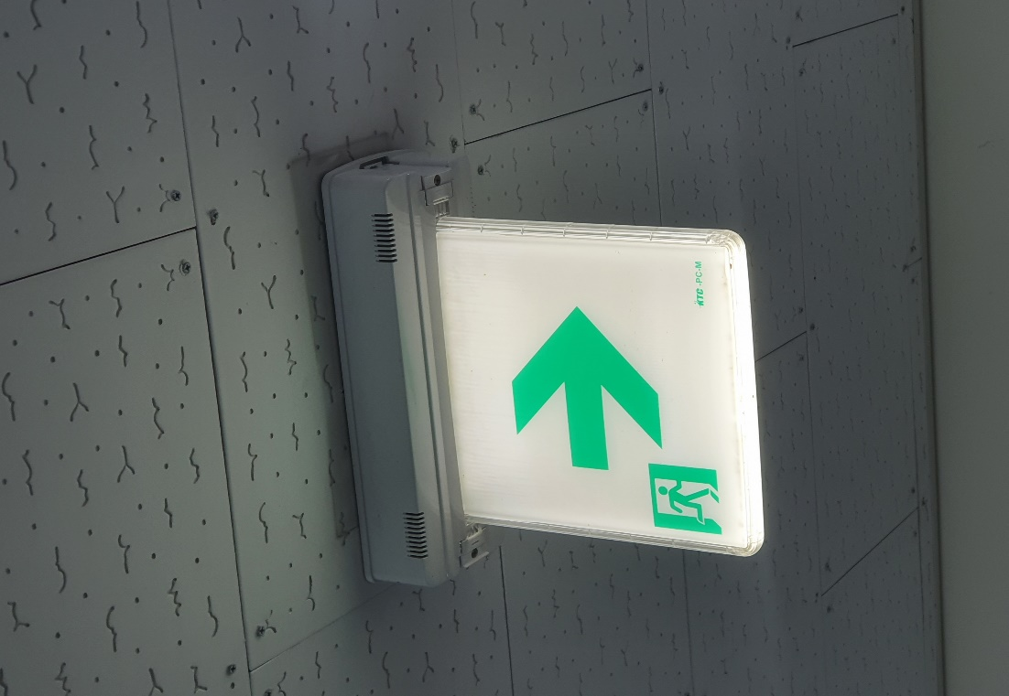
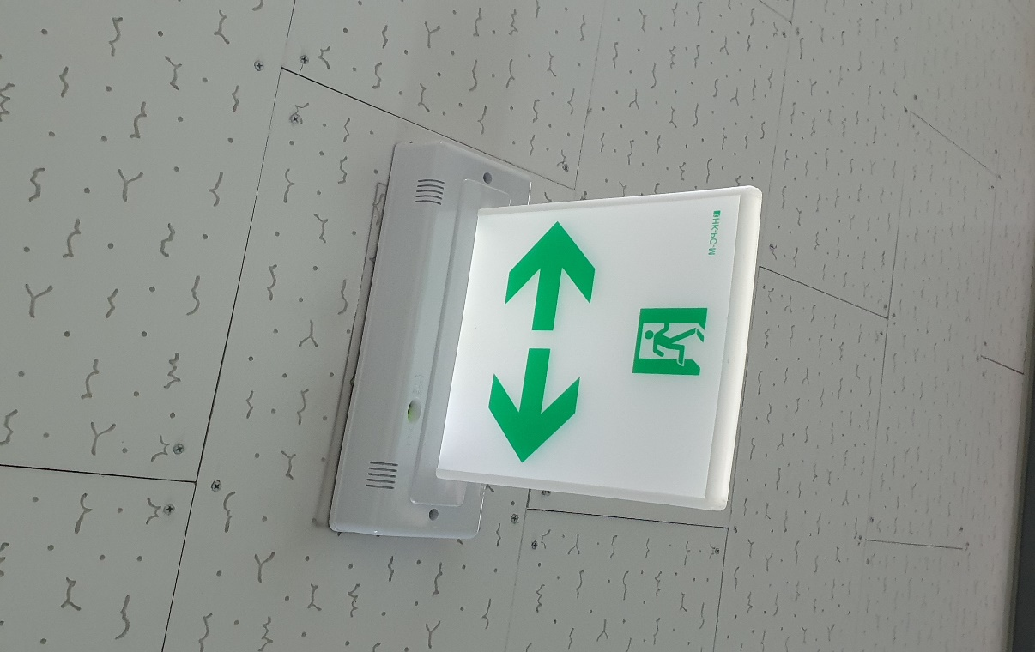
3. Experiment Design (1/5)
Experimental Object and Progress: 66%
Step 1
Binary Classification
1. Emergency sign
2. Others
Step 2
Multiple Classification
1. Emergency sign
Exit
Direction
2. Others
Step 3
Multiple Classification
1. Emergency sign
Exit
Direction
Left
Right
Bidirectional
2. Others

Slide 7
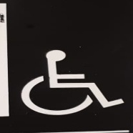

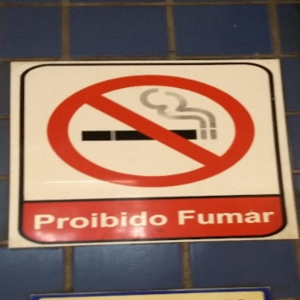




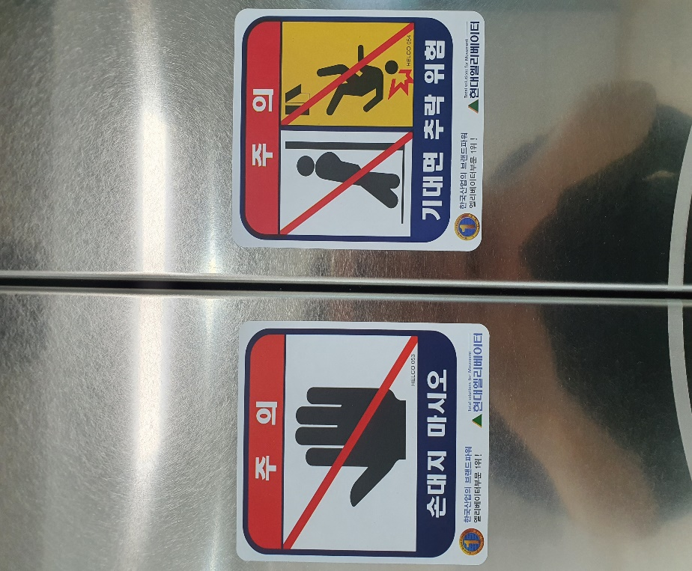


3. Experiment Design (2/5)
Dataset
Main issue: Imbalanced dataset
The number of samples for the class including others is much more than those of emergency sign.
The class consists of various signs such as accessibility, wi-fi, non-smoking, man-bathroom, woman-bathroom, Warnings
However, the classes about emergency signs would be smaller following the objective steps.
Figure 2. The composition of the classes

Slide 8
3. Experiment Design (3/5)
Dataset [Step 1]
Size [Class 1: Emergency, 2: Non-Emergency]
Train: 100[>>600], 590
Vali: 47, 36
Test: 10, 10
Data Preprocessing
Transform: Non-Cropping
Scaling: 1/255
Resizing: (224, 224)
Horizontal flip, vertical flip

Slide 9

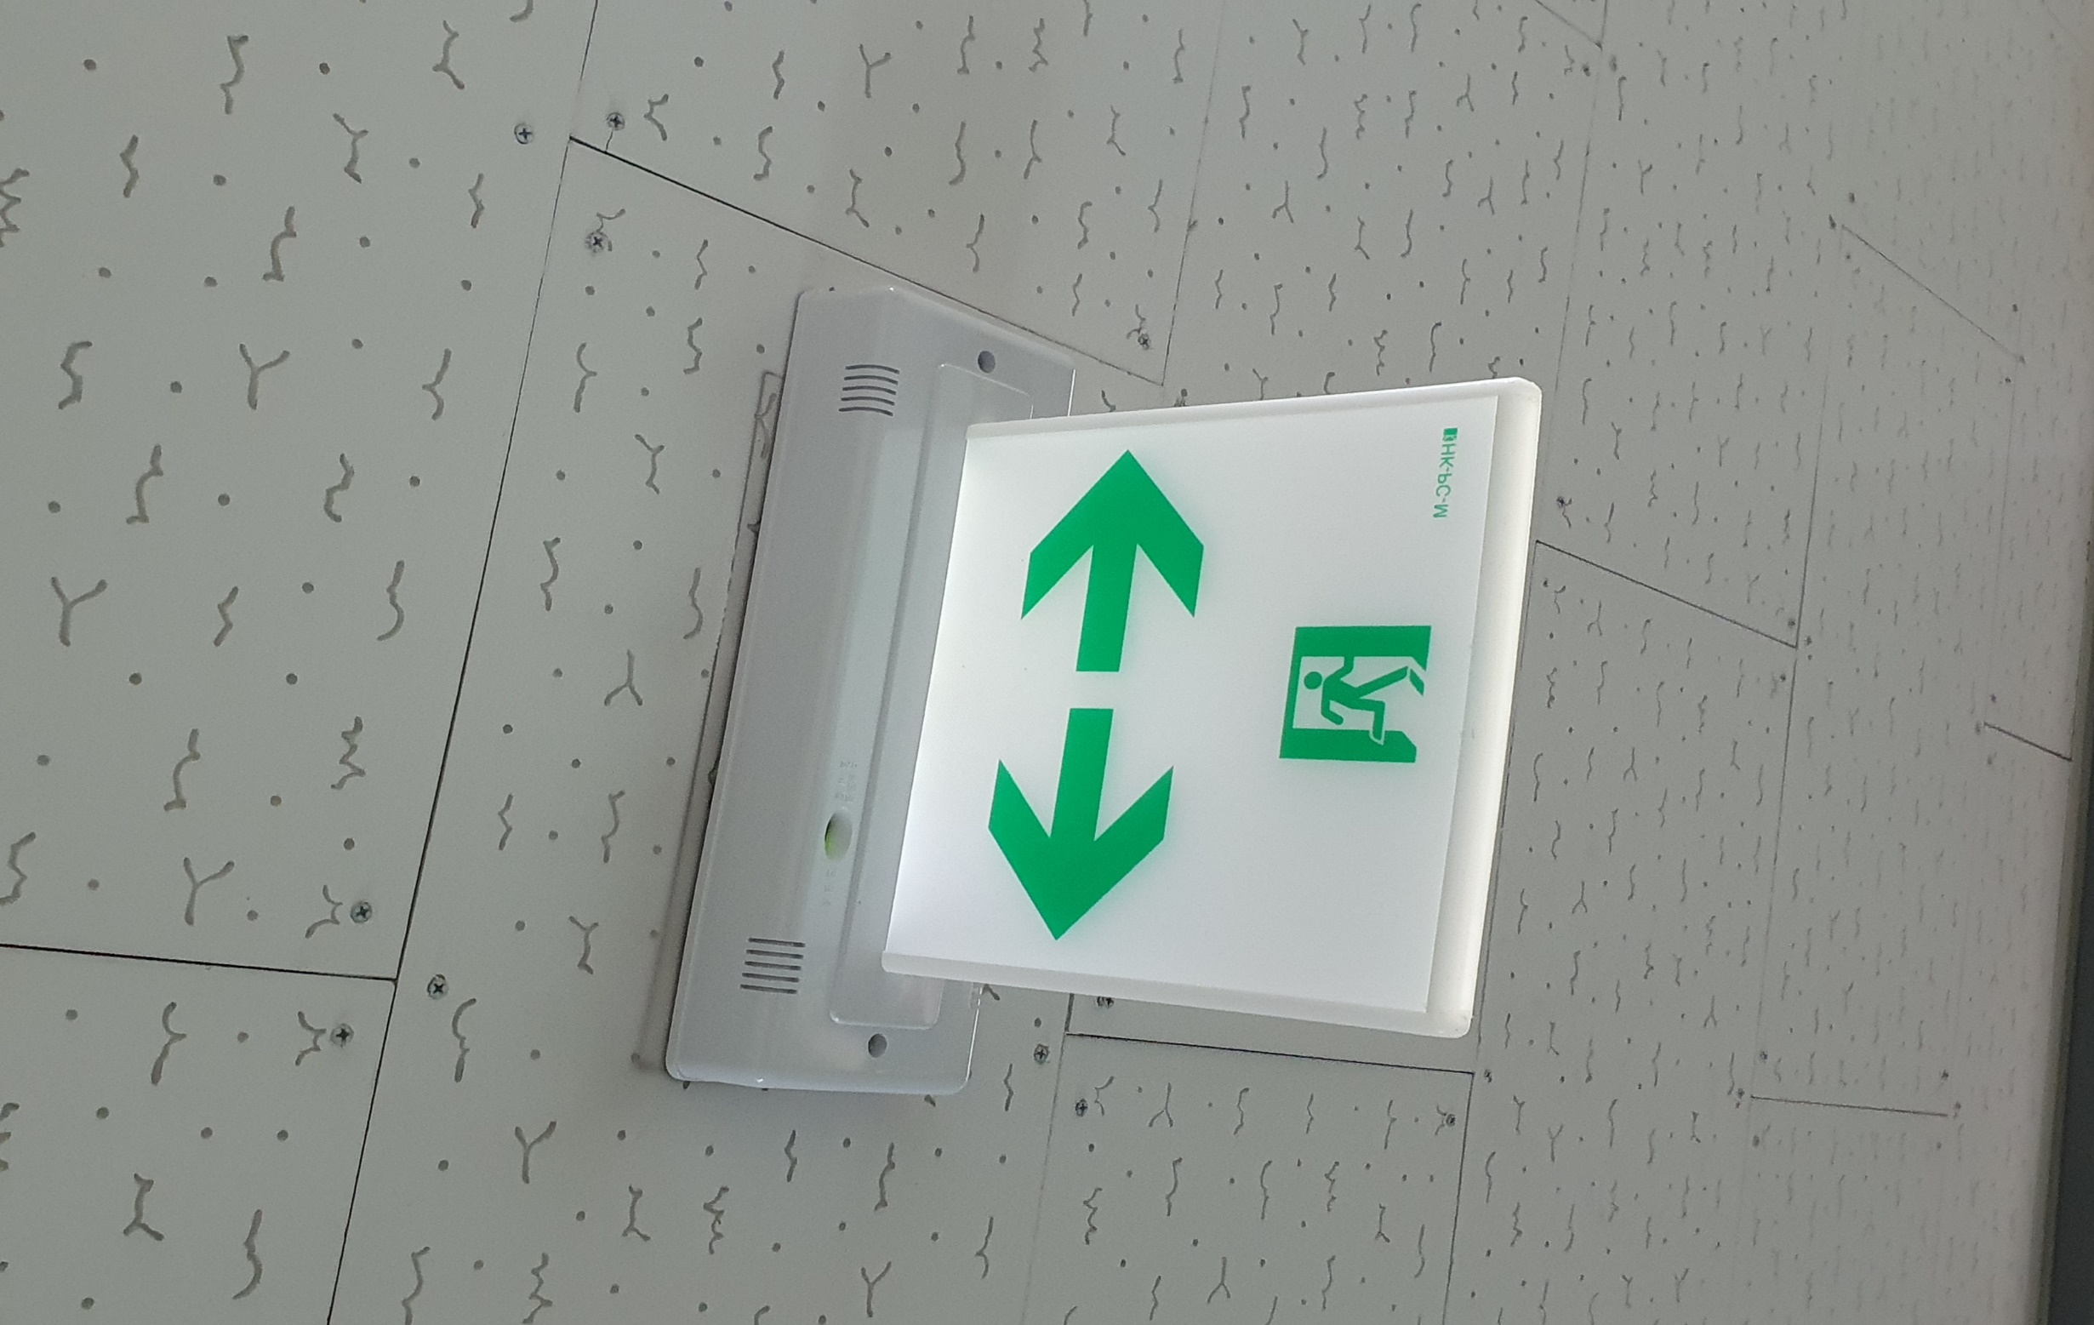
3. Experiment Design (4/5)
Dataset [Step 2]
Size [Class 1: Exit_Arrow , 2: Exit_Here, 3:Non-Exit]
Train: 65[>>1002], 35[>>1002], 590
Vali: 25, 12, 36
Test: 37, 13, 324
Data Preprocessing
Transform: Non-Cropping
Scaling: 1/255
Resizing: (224, 224)
Horizontal flip, vertical flip
Brightness range: [0.7, 1.3]
The parts of Emergency signs look similar each other
Figure 3. The comparison between the Emergency signs

Slide 10
3. Experiment Design (5/5)
Setting
Batch size: 64
Epoch: 20
Metric: AUROC
Early Stopping: If val_loss kept increasing more than 3 epochs, Stop
Monitor: Val_Loss
Patience: 3
Mode: min

Slide 11
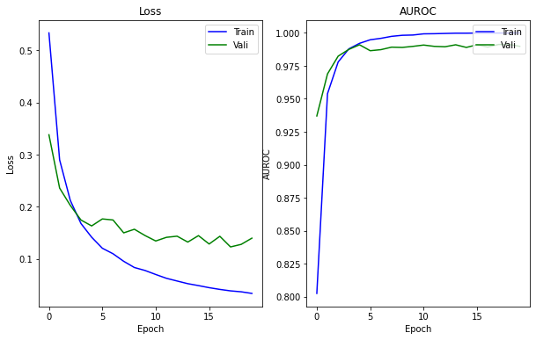
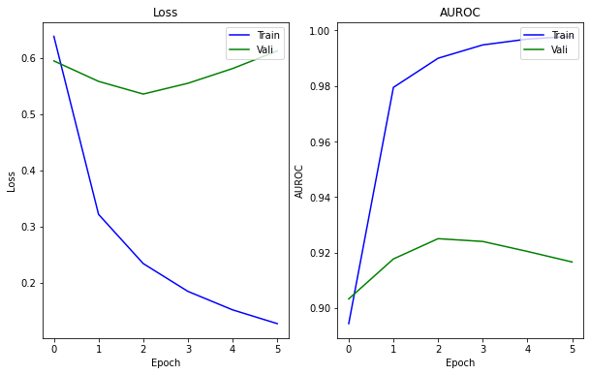
4. Result (1/4)
Scores
Train/Validation
Step 1
Loss kept decreasing
AUROC kept increasing
Step 2
Loss kept increasing
AUROC kept decreasing
Step1
Step2
Figure 4. Train Loss and AUROC scores

Slide 12
4. Result (2/4)
Scores
Test
Step 1
AUROC: 0.95
Step 2
AUROC: 0.9538
Parameters: Sklearn package, average=‘macro’, multi_class=‘ovo’
Macro: calculate metric for each label >> find unweighted mean
Ovo: One-vs-One, Computes the average AUC of all possible pairwise combinations of classes
True Predict | Emergency | Non-Emergency
Emergency | 10 | 0
Non-Emergency | 1 | 9
True Predict | Exit_Arrow | Exit_Here | Non-Exit
Exit_Arrow | 43 | 3 | 1
Exit Here | 4 | 14 | 0
Non-Exit | 10 | 3 | 310
Table 1. Confusion matrix based on the predictions

Slide 13
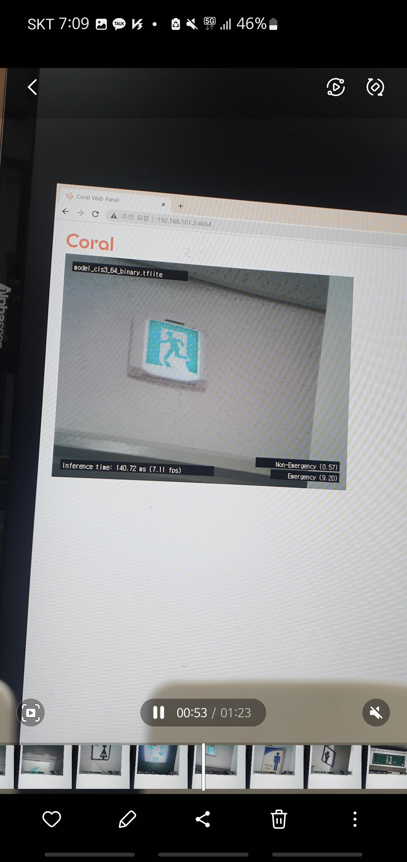
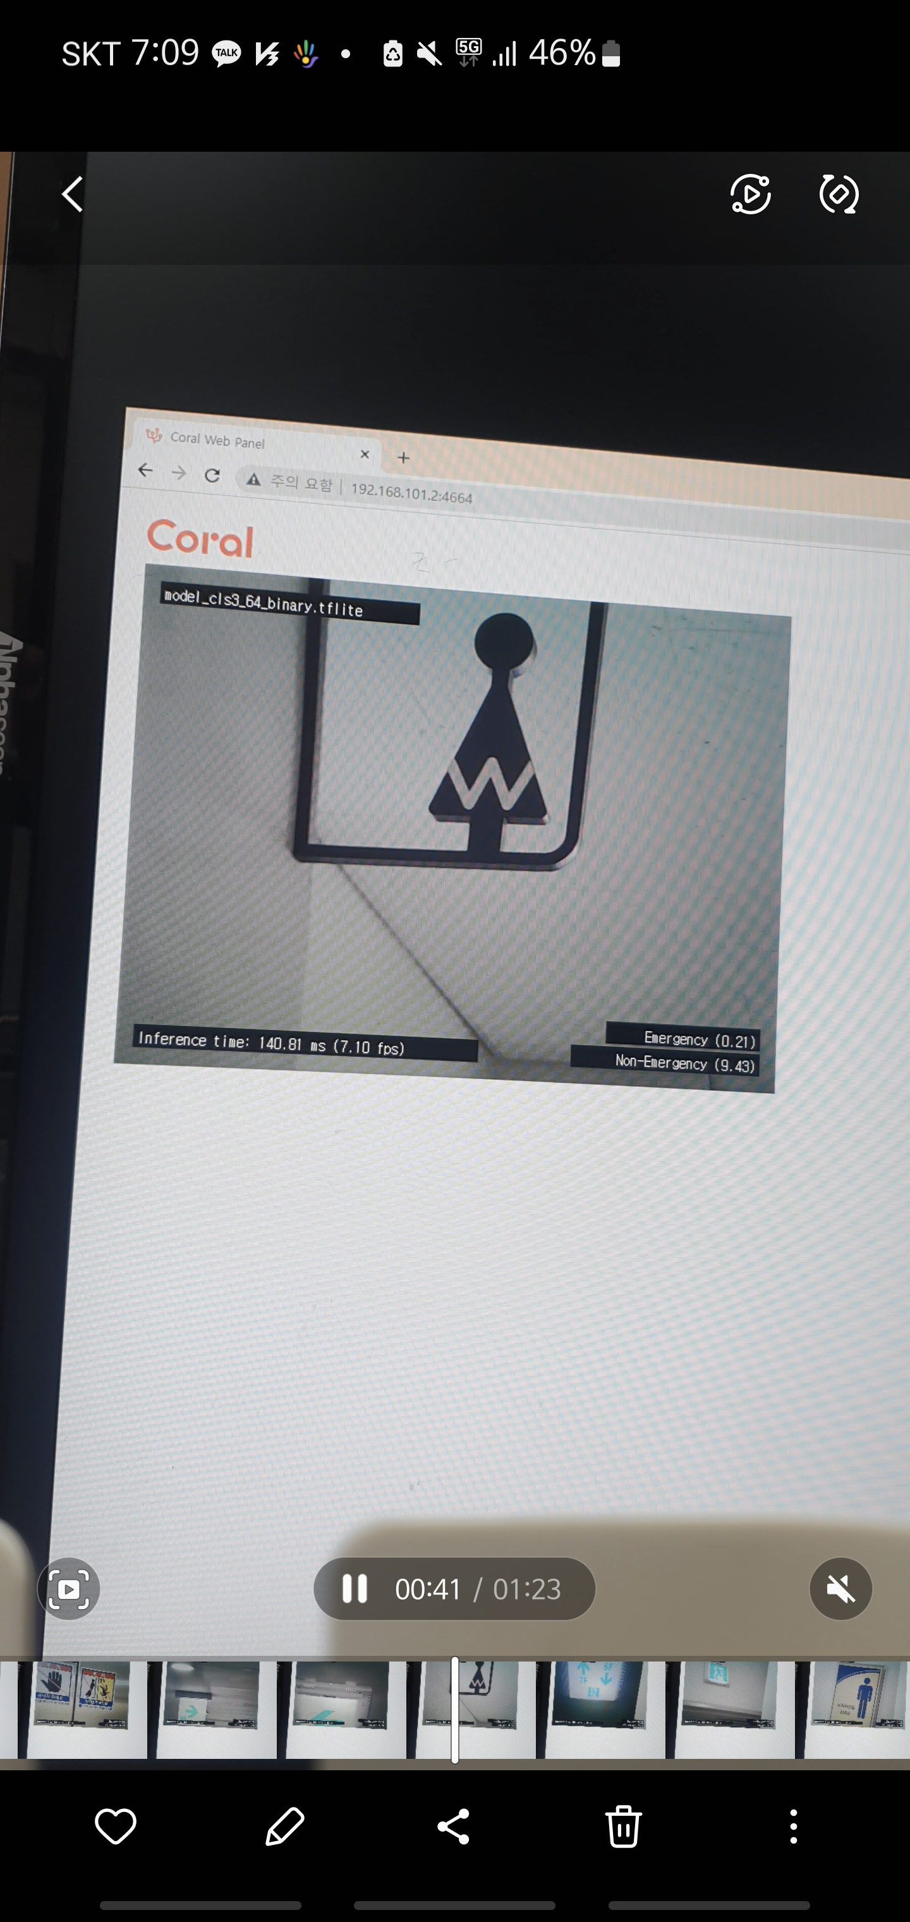
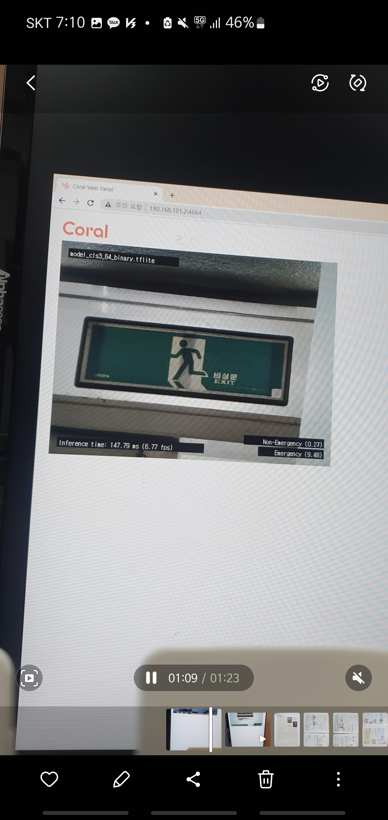
4. Result (3/4)
Inference [Step 1]
Images: 11 images collected manually
Inference time: generally, 140-150ms
The Sings are recognized well enough to be satisfied.
Emergency
[00:48~00:54]
(b) Non-Emergency
[00:41~00:42]
(c) Emergency
[01:16~01:20]
Figure 5. Inference examples of Step 1.

Slide 14
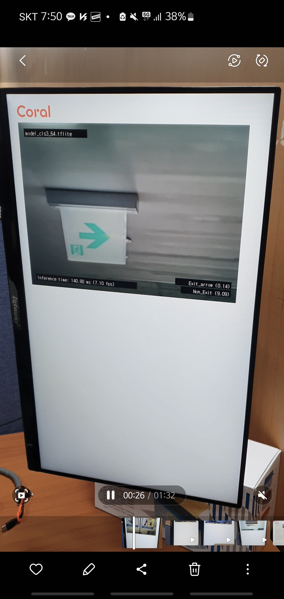
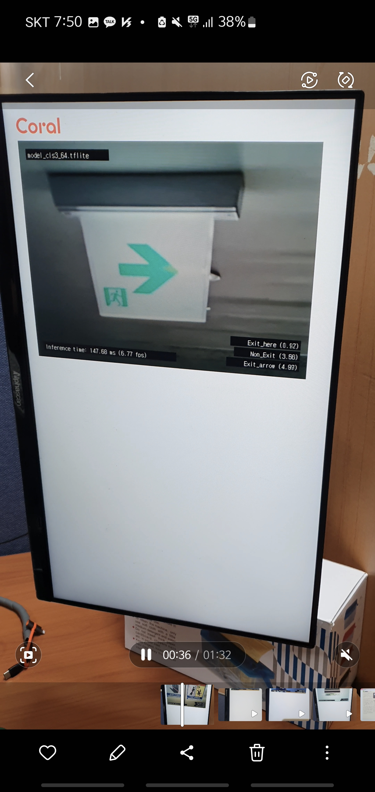
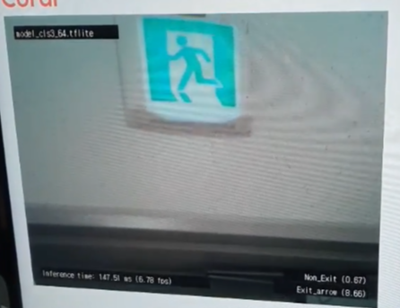
4. Result (4/4)
Inference [Step 2]
Inference time: generally, 140-150ms
It takes more time to recognize the signs correctly in the case of images with backgrounds like ceiling, wall, windows.
Exit_Arrow
[00:18~00:39]
(b) Exit_Here
[01:01~01:02]
Figure 6. Inference examples of Step 2.
Notes:
18-39
01:25-01:31

Slide 15
5. Discussion
Application
High learnability: easy to use
Low Usability: Difficult to detect specific sign among signs
Future work
Considering directionality of emergency signals for route notification.
More datasets are needed.
Choosing a target device.

Slide 16
QnA

